Slide 1
LINKING TAHOE A Transit Connectivity Initiative
CONNECTING COMMUNITIES
A Focused Regional Capital and Operational Delivery Strategy
Notes:
Acceleration

Slide 2
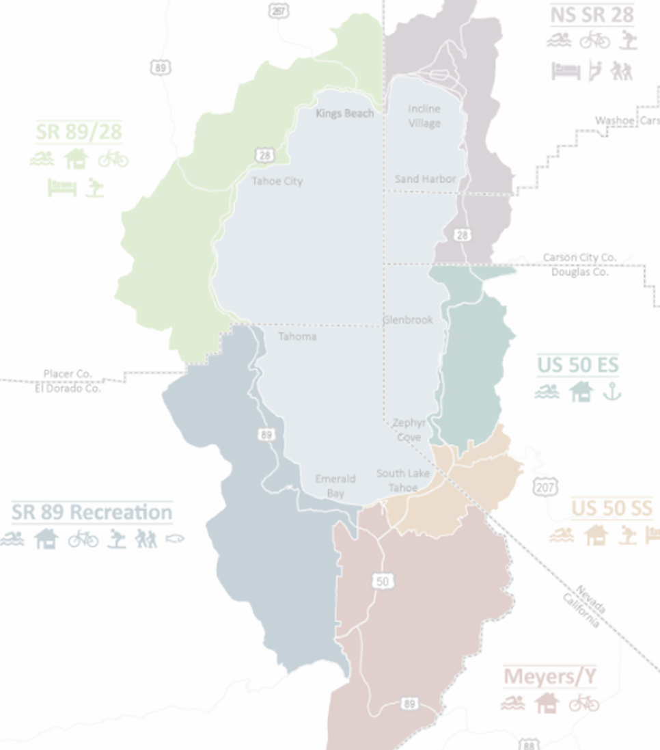
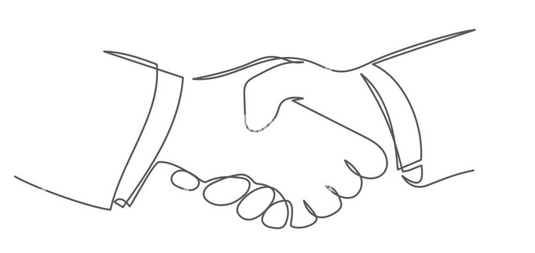
Vision
Unify local and regional partners in a concentrated effort towards development of a legislative and local funding strategy to deliver key regional transit-oriented projects that would link urban zones, communities, and recreation corridors within the Lake Tahoe Basin, and connect to the greater California/Nevada region.
Linking Tahoe Connectivity Initiative
Notes:
Add local funds

Slide 3
Goals
Establish a “seamless to the rider” connected regional transit priority project package to support the RTP goal of increasing non-auto mode share by at least 5% by 2028
Achieve unified local and regional partner consensus towards a substantial legislative funding effort to deliver regional connectivity capital projects
Achieve unified local and regional partner consensus towards establishing local funds for shared responsibility in supporting transit & multi-modal operations
Commit to a significant fifteen-year capitalization effort of regional public transit needs similar to previous EIP water quality program emphasis
Linking Tahoe Connectivity Initiative

Slide 4
Summit Expectations
Clear recognition that the time is NOW to fund Transit capital and programming for the next 15 years
0-5 years – Local/Urban Interest
5-15 years – Recreation corridors/regional
Clear recognition that the basin needs mid-term fund infusion to “jump start” short/mid/long term delivery
Clear recognition of local jurisdictions and partnering agencies that local fund development is critical to support local and inter-regional transit operations.

Slide 5
Objectives
Establish Regional year-round connectivity between I-80 and US 50 Corridor within 15 years
Construct mobility hubs and related infrastructure specific to regional connectivity
Strive for 30-minute headway on fixed route service as a baseline. Analyze and plan projects in which 15-minute headways might be realized
Develop paid parking and park/ride sites specific to mobility hubs and recreation access to support transit O&M
Develop and implement Mobility as a Service (MaaS) technology to provide unified multi-modal trip planning
Plan introduction of passenger ferry as North/South urban zone connection method
Linking Tahoe Connectivity Initiative
Notes:
30 minute headway – TART or Regional. Delete 15 minute

Slide 6
Background
All of the projects proposed within the Linking Tahoe Connectivity Initiative are a sub-set of projects identified in the current Regional Transportation Plan (RTP) and included within the approved Linking Tahoe Corridor Management Plan and the Linking Tahoe Transit Plan
The projects have been vetted through the Bi-State Consultation on Transportation and the Tahoe Transportation Implementation Committee to be determined priority regional transit projects.
Linking Tahoe Connectivity Initiative
Notes:
Transportation

Slide 7
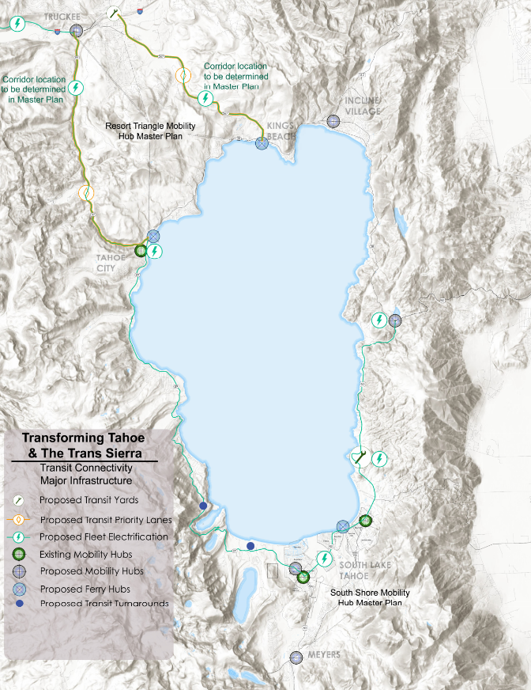
Capital Projects
Linking Tahoe Connectivity Initiative

Slide 8
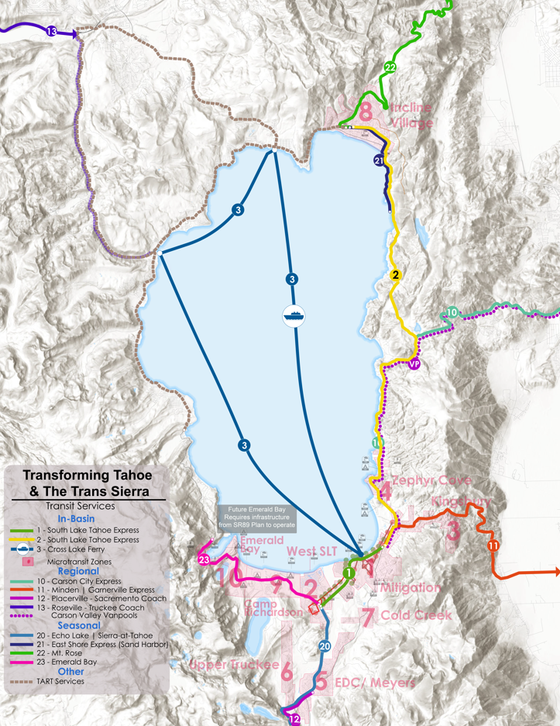
Operations Programming
Linking Tahoe Connectivity Initiative

Slide 9
Funding
Federal Legislative (Regional Capital Projects)
Earmark
EIP
State Legislative (Capital Projects and Operations Programming)
Local (Local Capital Projects and Operations Programming)
Establishment of fund distribution metrics
Linking Tahoe Connectivity Initiative
Notes:
Check with Peter for the TIRCP info and see where this can tie in

Slide 10
Discussion
Rationale of Implementation Benefit
“Time is NOW”
Regional/Local project inclusion/integration
Delivery
Linking Tahoe Connectivity Initiative

Slide 11
Expected Conclusions
TTD and TRPA Board Agreement
Regional Consensus
Implementation Priority Policy of Next RTP
Commitment to Long Term Legislative Strategy
Linking Tahoe Connectivity Initiative

Slide 12
Questions
?
Linking Tahoe Connectivity Initiative

